Slide 1
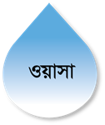

Dhaka WASA Water ATM Booth
Project Overview (2017- 2021 )

Slide 2
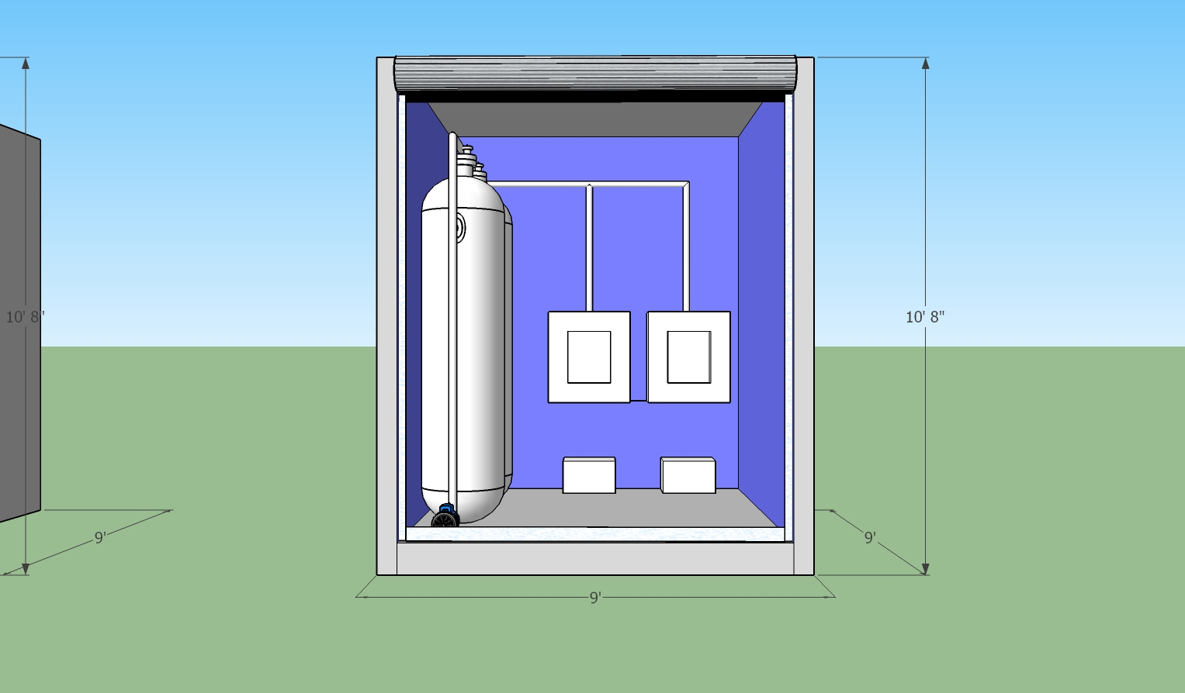
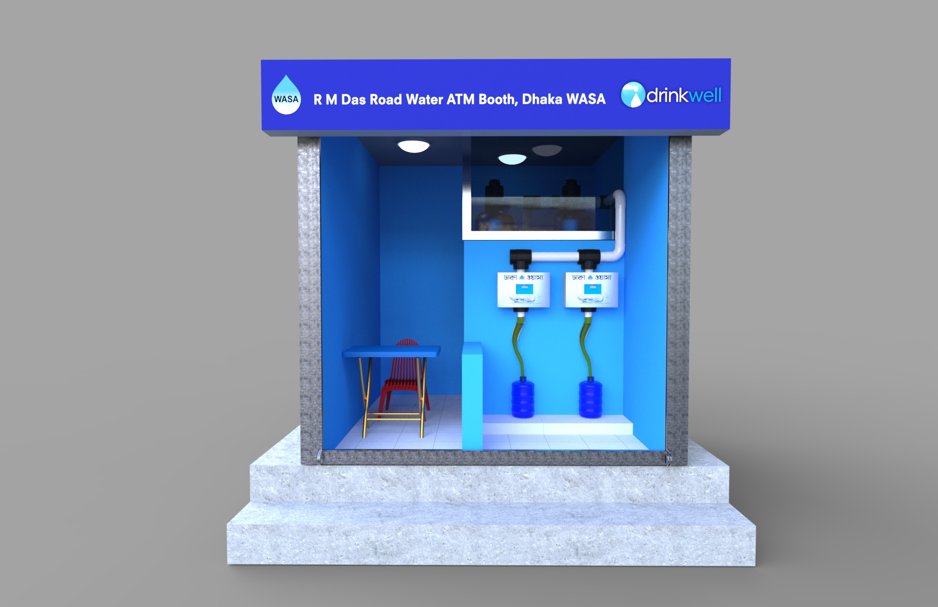
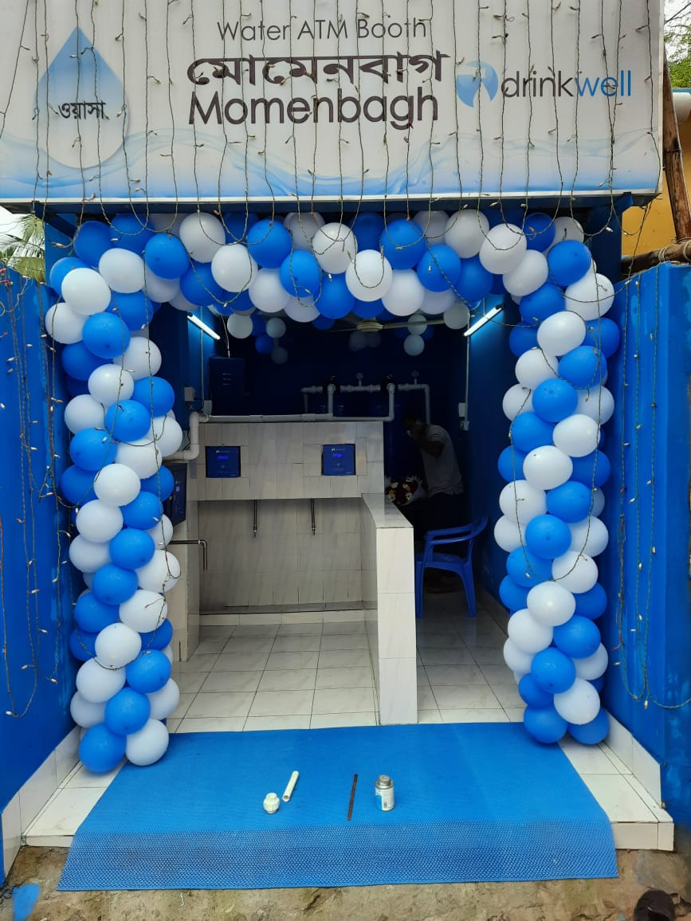
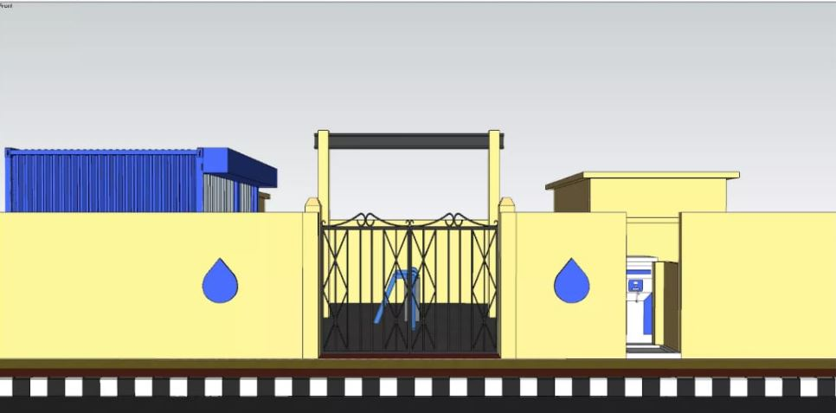
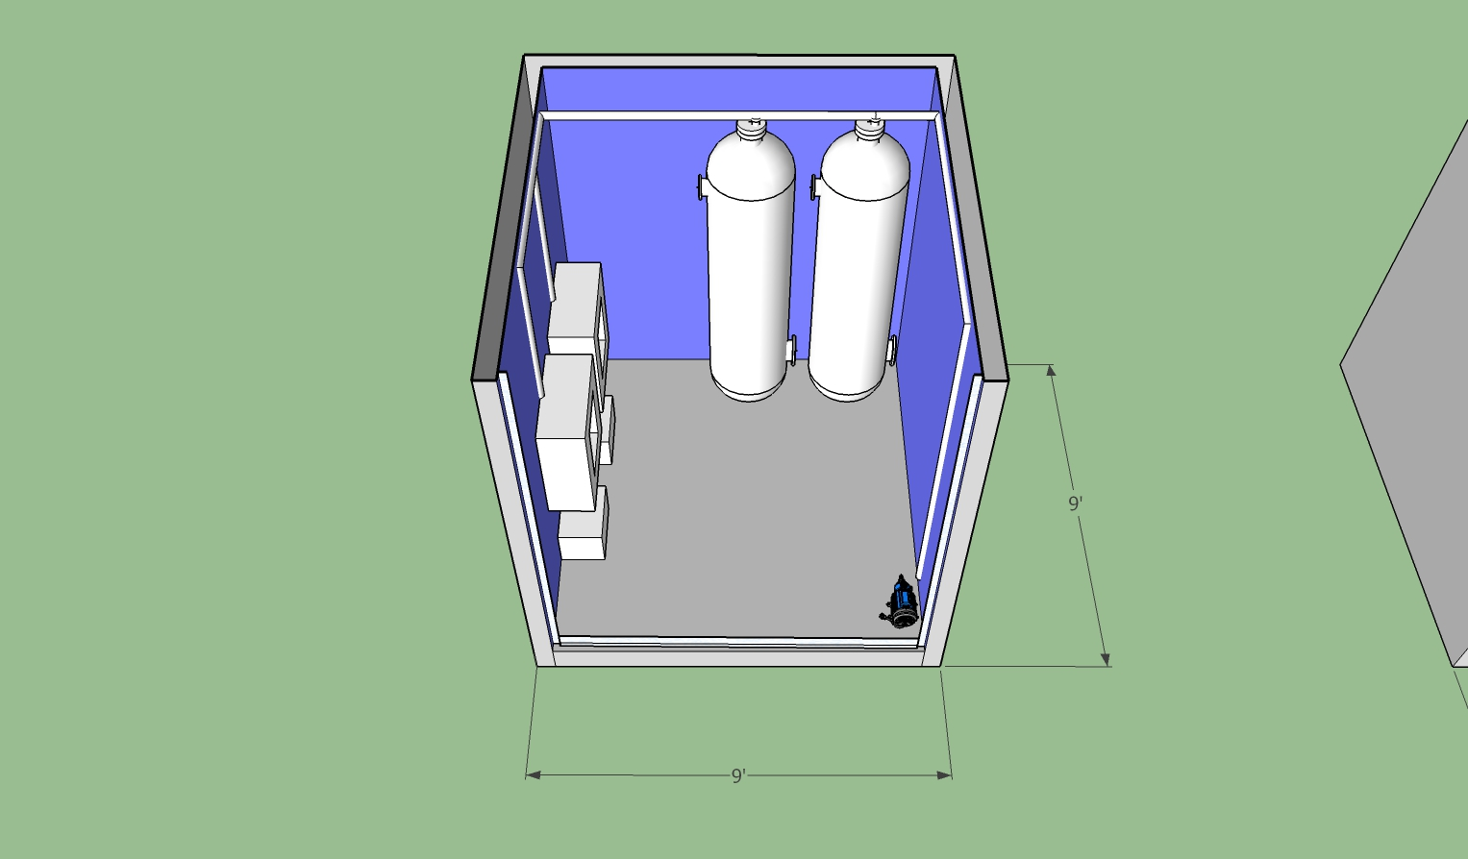
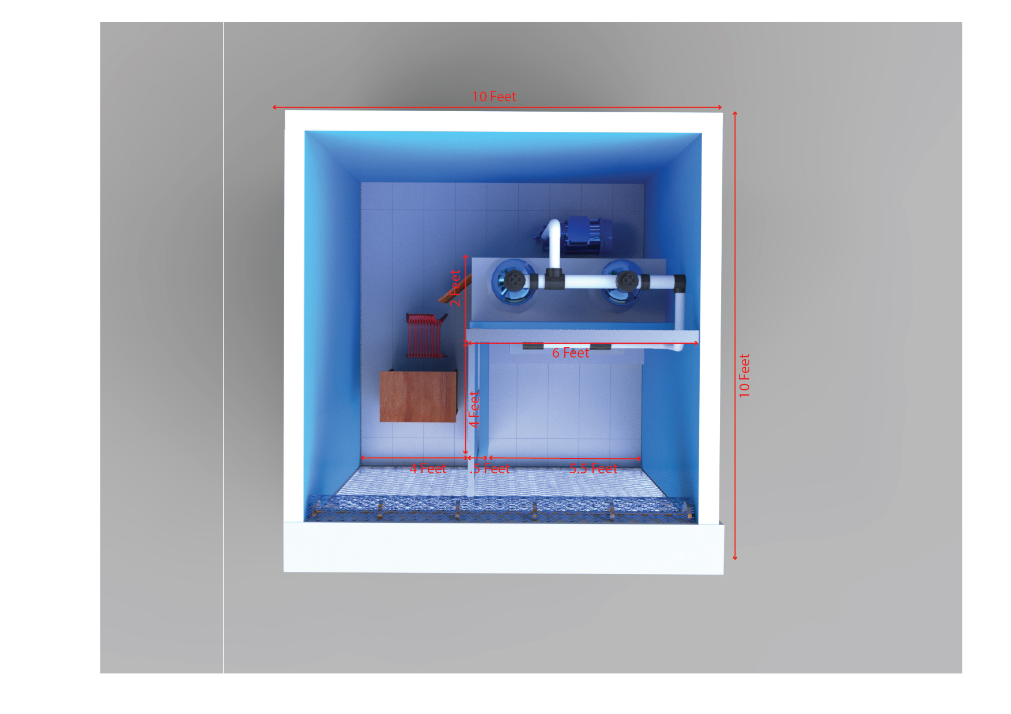
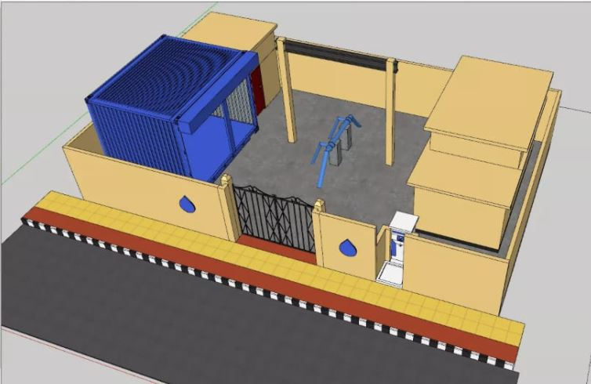
Design Overview
Design (2017-2018)
Design (2019-2020)
Design (2021 )
Design ( From July 2021 )

Slide 3
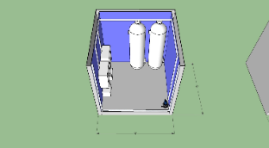


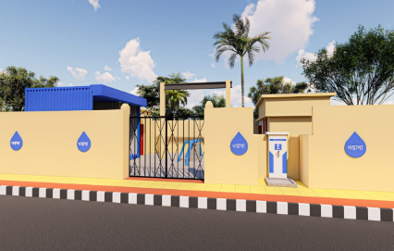
Design | Advantages | Limitations | Picture
2017-2018 | bigger space available for customers for taking water and keeping jar inside the booth (Measurement 12' * 12') | - a lot of space needed to build a atm booth (not everywhere this space is available) - customer and other local people gather in the open space of atm booth - filtration system is exposed infront of all people
2019-2020 | -a lot of space is not needed for building a atm booth. we can prioritize to evaluate site according to sales and customer requirements. - Filtration system installed behind of the local premises which should not be exposed to all local agents. - Booth operator has a separate place to sit and do his/her work infront of camera. - customer do not need to enter into the whole booth to take water, they can just stand in front of the dispensing unit and take water comfortably. (Measurement 10' * 10'. Dispensing unit separated from filtration system) | - In some places, we can not build atm booths on street to get more focus from the consumers.
2021 | Customised design & measurement applied considering sales perspective. Introduced in April '2021 ATM box ignored thus there is no way for consumers to access / manipulate our system. Mandatory brick wall applied to prevent stealing. | Customers can't collect water after operating hours.
In Future | Introduced Manless operation in july 2021. Customers will be able to collect water after operational hours.

Slide 4
Financial Mapping
Year | Number Of System Installed | Number Of System Online | Total No. Of Card sold | Total No Of card sold amount | Customer Recharge | Total Revenue | O&M Bill | Dhaka WASA Payout
2017 | 6 | 6 | 3,615 | 1,084,500 | 1,033,190 | 2,117,690 | 760,000 | 1,357,690
2018 | 62 | 62 | 14,658 | 4,397,400 | 12,623,734 | 17,021,134 | 9,834,239 | 7,186,895
2019 | 127 | 124 | 31,629 | 4,611,650 | 34,656,067 | 39,267,717 | 33,310,247 | 5,957,470
2020 | 198 | 181 | 41,382 | 3,817,400 | 44,506,452 | 48,323,852 | 58,589,578 | -10,265,726
2021 (Jan-Feb) | 198 | 173 | 8,828 | 459,250 | 7,394,465 | 7,853,715 | 9,703,107 | -1,849,392
2021 (March-June) | 240 | 211 | 32,957 | 2,679,650 | 26,067,772 | 28,747,422 | 20,846,084 | 7,901,338

Slide 5
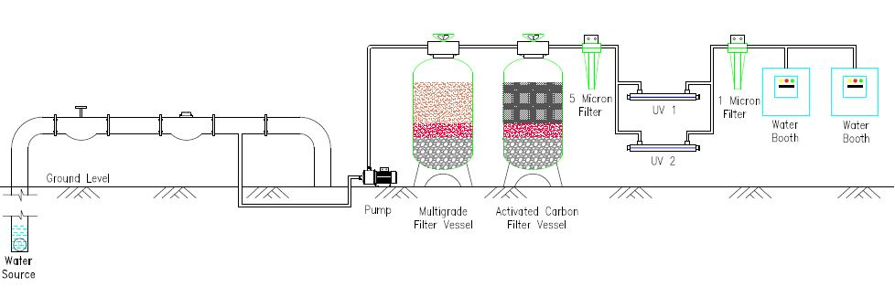
Flow Diagram
Fig 1 : Above diagram mainly used for Surface water purification. Where higher concentration of chlorine & heavy metal have found. Example: Nazirabazar, sikkatuli, narinda-1 water ATM etc

Slide 6
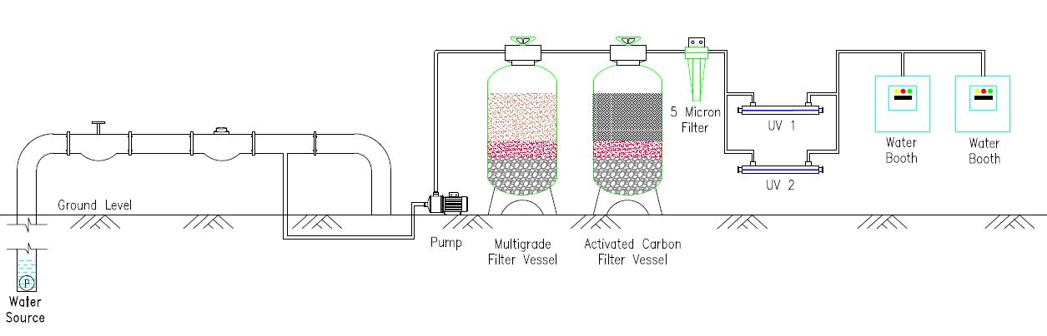
Flow Diagram
Fig 2 : Above diagram is used where we found sustainable quality water with low deviation in parameters. Such as Matuail 01 water ATM Booth.

Slide 7
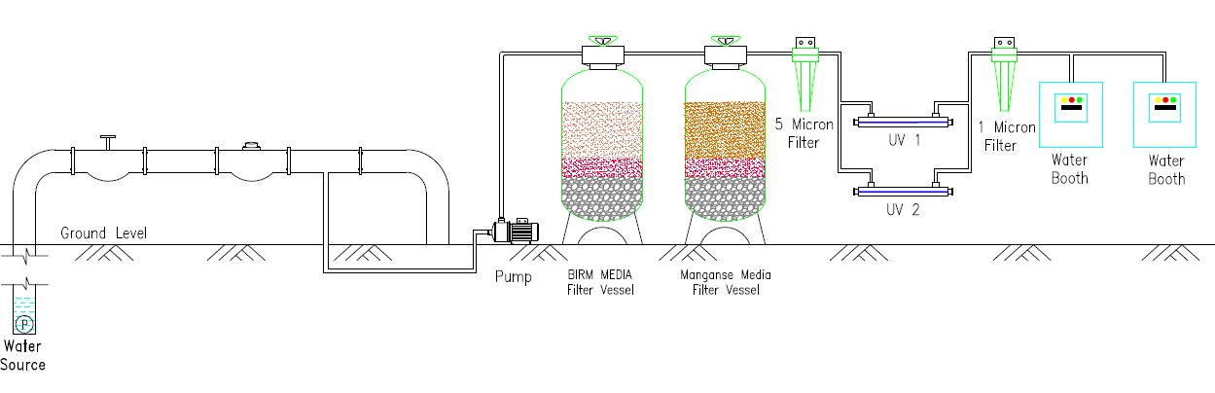
Flow Diagram
Fig 3 : Step three is mainly used to control excessive iron oxide from water. We've deployed it where above 2 PPM iron is present. Example: Iraqi kabarsthan, RM das lane water ATM etc.

Slide 8
Innovation In Filtration
In 2018, beside our common filtration system, We applied Ultraviolet lamp for preventing Microbial contamination.
In October 2019 we applied a 5 micron sediment cartridge to avoid visible components
For Removing strong concentration of chlorine from source water we added GAC in our multimedia tank.
After discussing With Engr.Ramaswer Sir we've introduced an additional 1 micron cartridge in our new systems, thus customers can store it above 48 hours.
To maintain quality service & customer satisfaction we test all our treated water samples from a Govt. Authorised Laboratory in every three month interval.

Slide 9
Booth Operator Initiatives
To make fully digitalized & IoT base operation we've deployed Google form to collect daily sales data, logsheet, attendance sheet, CC camera for mass monitoring to our ATMs.
Creating positive mindset & close attachment with operation we launched sales incentive, employee of the month & KPI based service among our operators.
Continuing a Vast training session of two month time period based on SOP, Hygiene, sanitation,behaviour,attitude, & customer interaction to all our 300+ operators.
We are also discussing about weekly holiday for caretakers to reduce stress, anxiety & working hour.

Slide 10
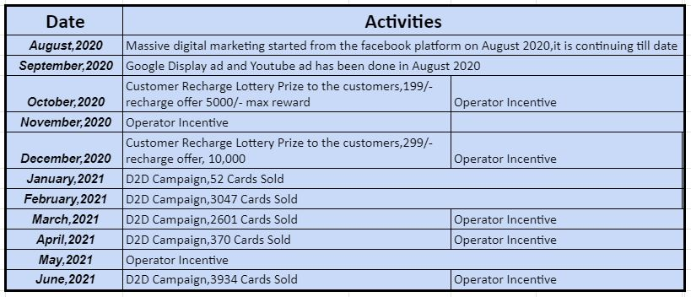
Marketing Initiatives

